Slide 1
Online Employee Leave Management System
Tushar Das
BSc Computer Science (Hons), University Of Calcutta
CU Roll no. :
213017-21-0071
CU Reg No. :
017-1111-0615-21

Slide 2
Introduction
The efficient management of employee leave is a cornerstone of a healthy organizational ecosystem. This project aims to develop a web application that automates and streamlines this crucial process.
This system will offer functionalities for employees to submit electronic leave requests with attachments, track their leave balance etc.
This system will also implement secure, role-based access control, allowing managers to review and approve leave requests.

Slide 3
Motivation and Scope of the Work
The motivation for this project stems from the inefficiencies and lack of transparency in traditional paper based leave management systems.
These issues often result in administrative burden and dissatisfaction among employees and managers.
Our goal is to develop a streamlined user friendly web application that automates leave request and approval process, enhancing efficiency, real-time data accessibility, and overall user experience.

Slide 4
Review of Related Work
Commercial Systems:
BambooHR ($12,500 to $77,600): Employee onboarding, administrative supports, leave management with mobile-friendly interface, and payroll calculation.
Zoho People ($0 to $65 per month): Recruitment, onboarding, performance analysis, leave management with mobile access and payroll calculation. However, the free plan doesn’t provide any significant features.
Opensource Systems:
OrangeHRM (Free and open-source): Leave requests and approvals, managerial tools, advanced features like recruitment assistance and payroll integration paid version.
OpenHRMS (Free and open-source): Suitable for organizations willing to maintain their own systems. Offers Leave tracking, requests and approvals, payroll processing, HR administration and reporting tools.

Slide 5
Proposed functionalities
This online system should be capable of
Role-based Access Control
Hierarchical Approval System
Leave Application Submission
Leave Balance and Leave Request Status Tracking
Manager Review

Slide 6
Technologies Used
Front-End
HTML, CSS, JavaScript
Server-Side
PHP
Database
MySQL
Version Control
Git & SourceTree GUI

Slide 7
Clip 0 Login system
Short demo video

Slide 8
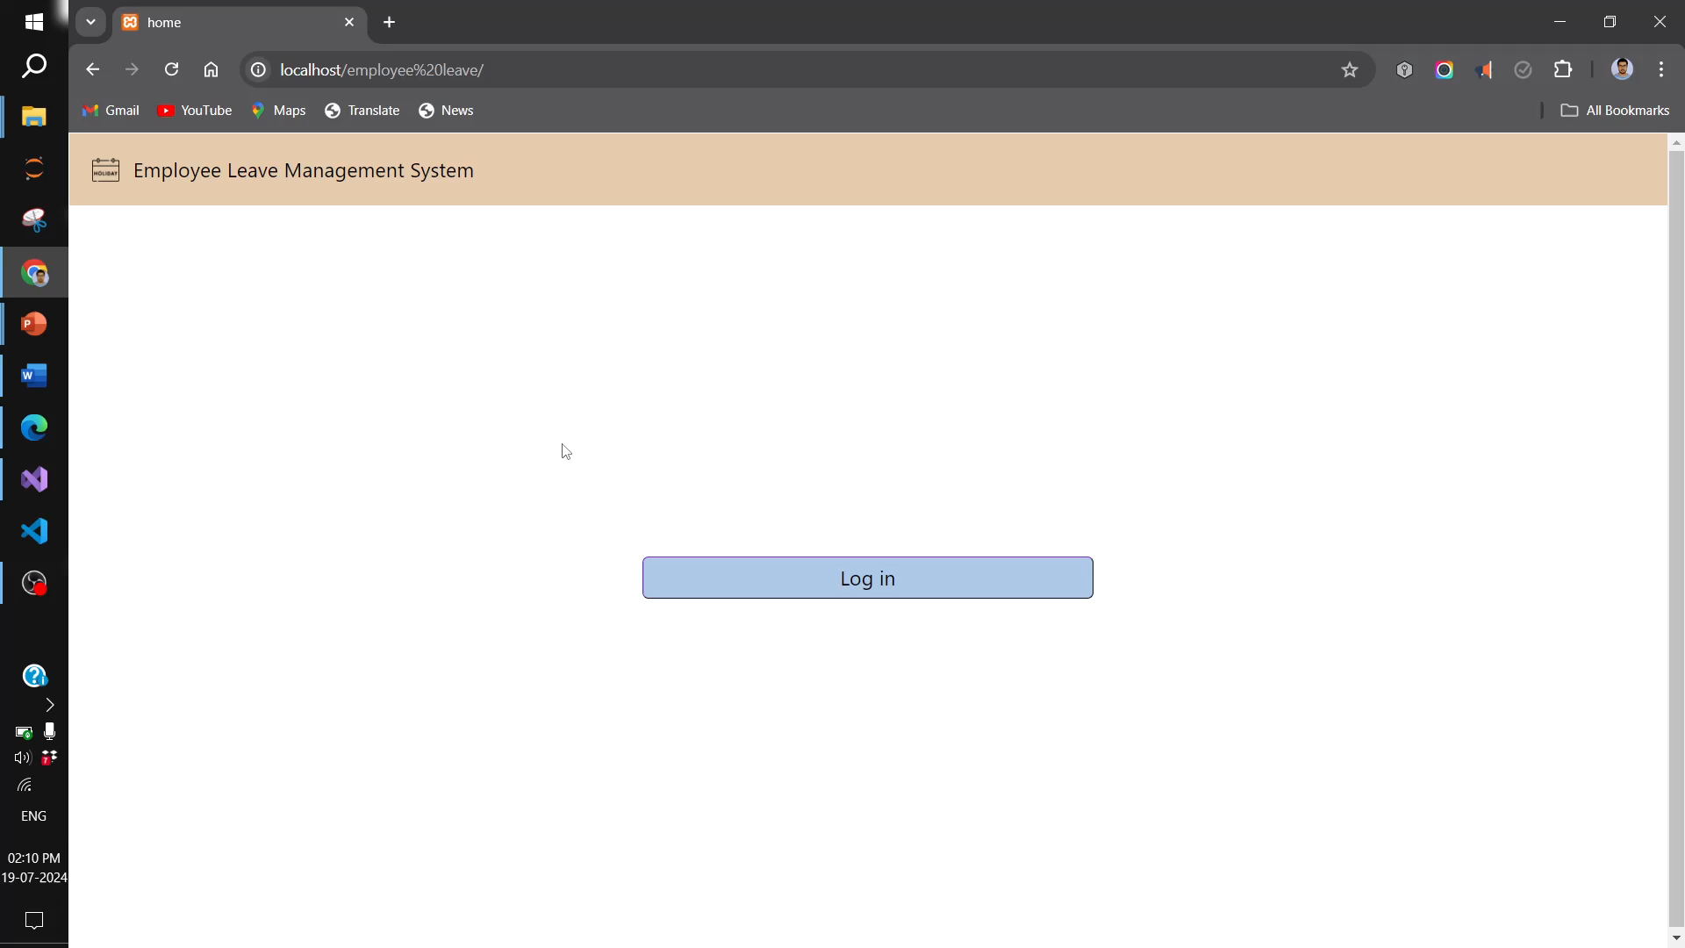

Slide 9
Clip 1 Leave Application
Short demo video

Slide 10
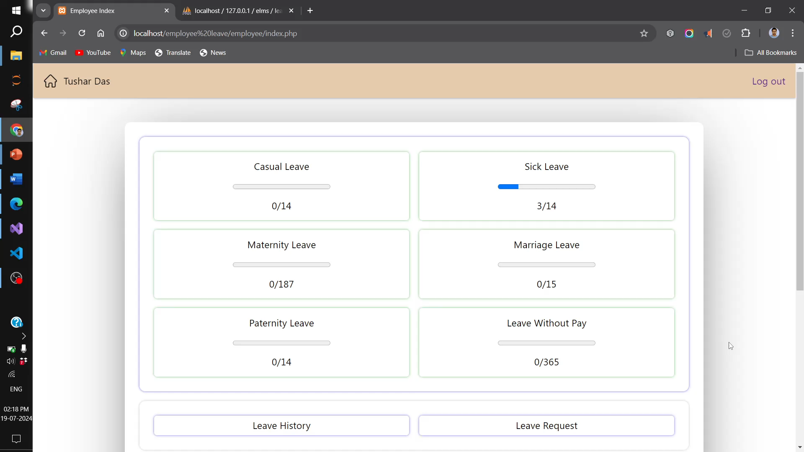

Slide 11
Clip 2 Manager 1 consent
Short demo video

Slide 12
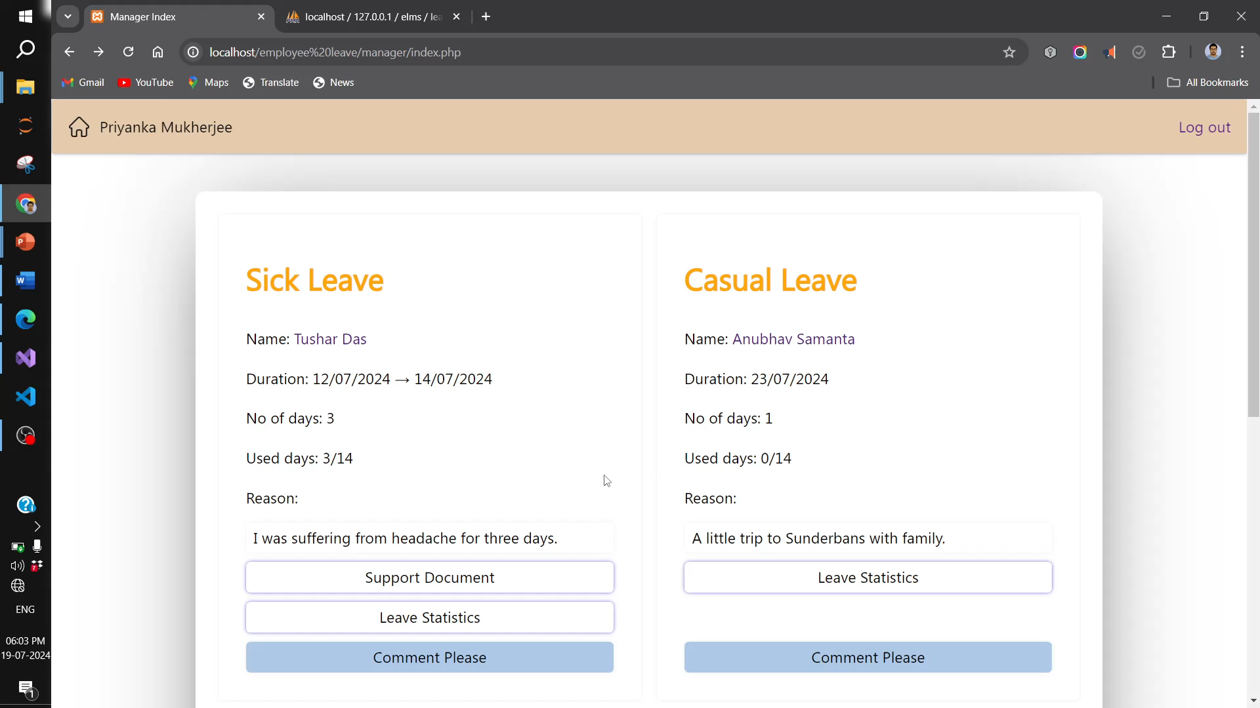

Slide 13
Clip 3 Manager 2 Approval and Decline
Short demo video

Slide 14
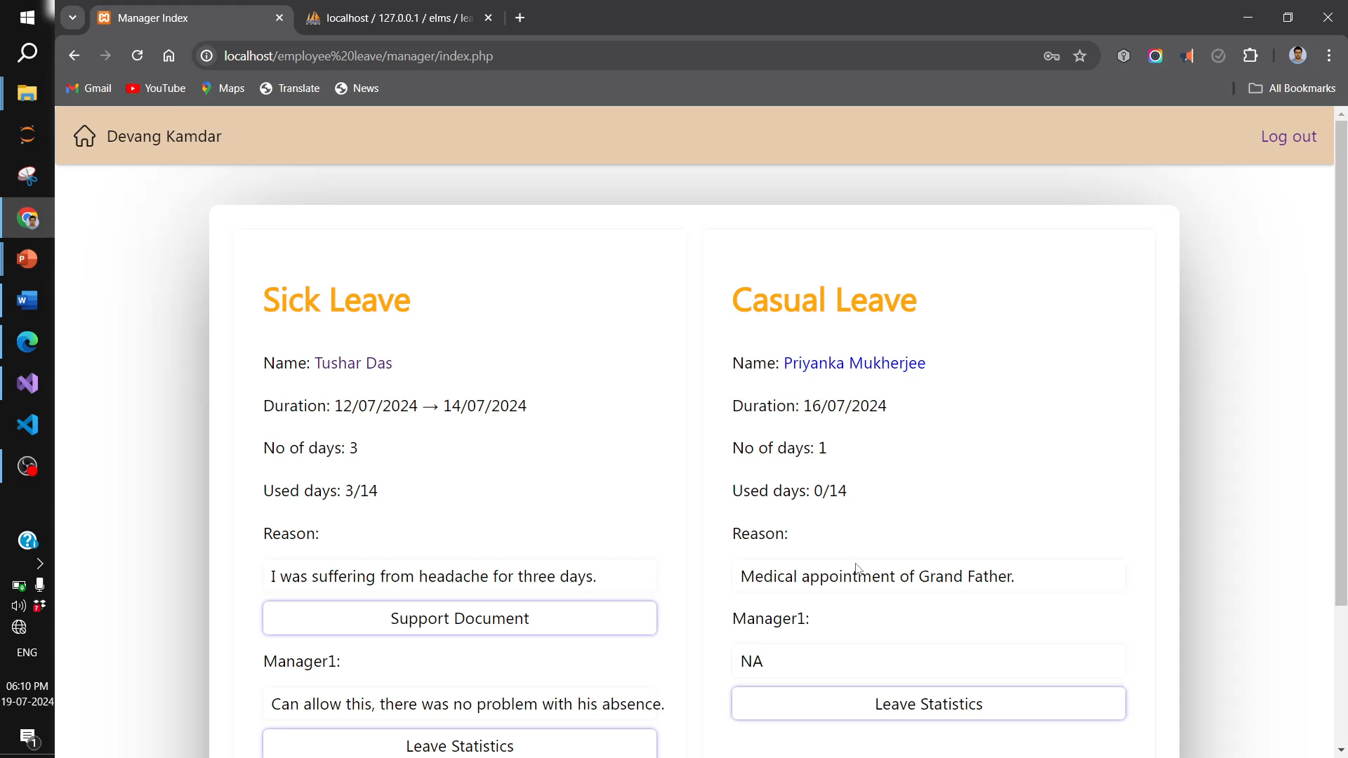

Slide 15
Clip 4 error Handling (Invalid Input)
Short demo video

Slide 16
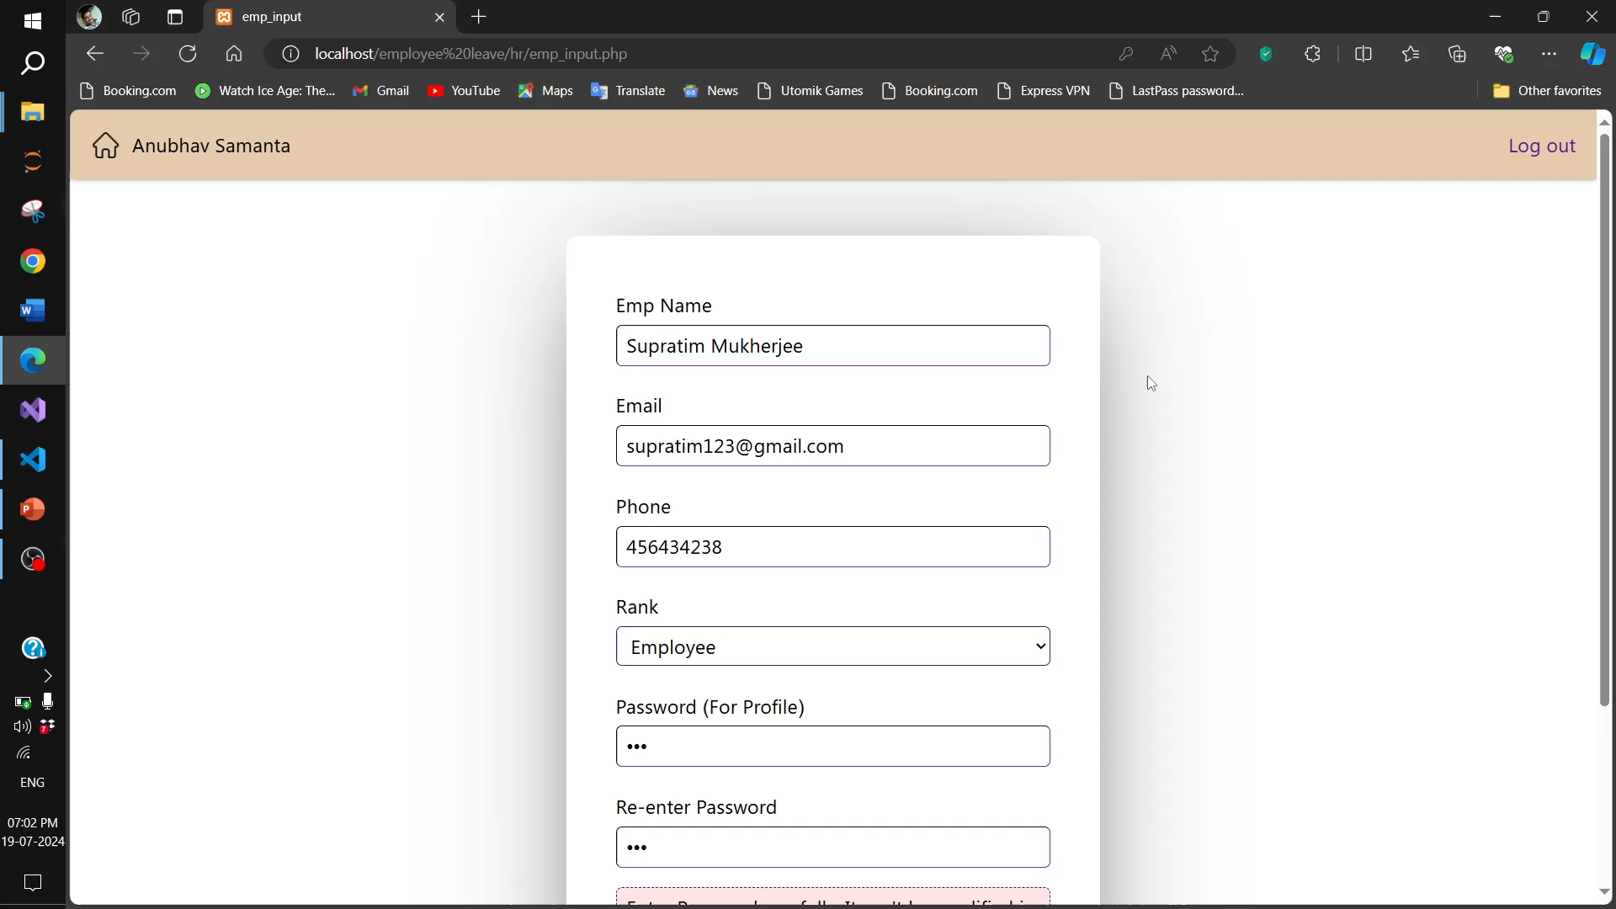

Slide 17
Clip 5 error Handling (Invalid URL Parameter)
Short demo video

Slide 18
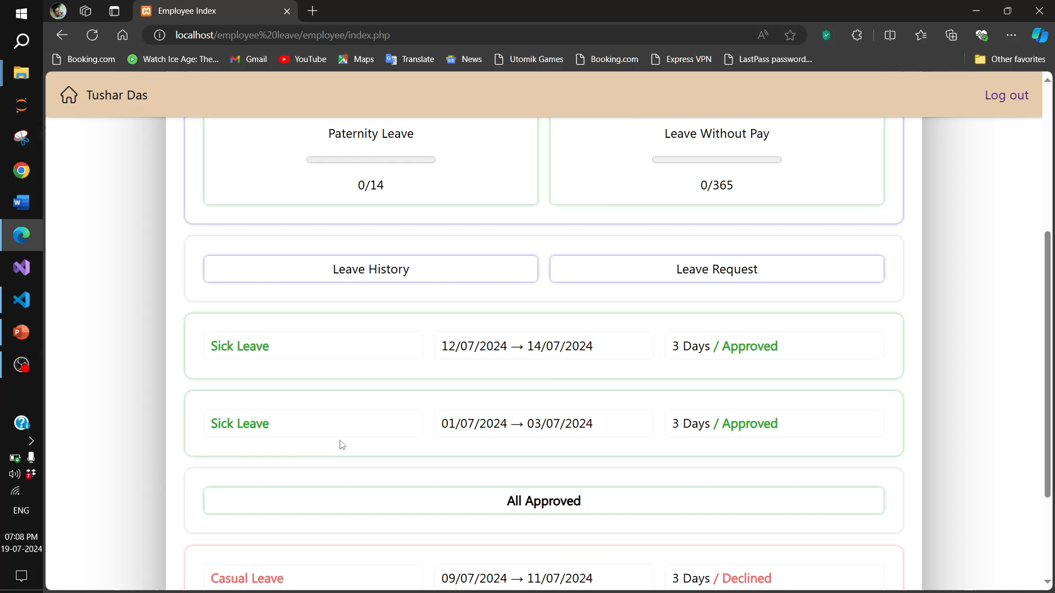

Slide 19
Future Enhancements
Departmental approval workflow.
More complex leave rules.
Advanced working days calculation.
Leave trends analysis.
Further optimization.

Slide 20
Thank You

